Slide 1


Slide 2
Business Arround the world
Without futher ado...

Slide 3
Business in Japan

Slide 4
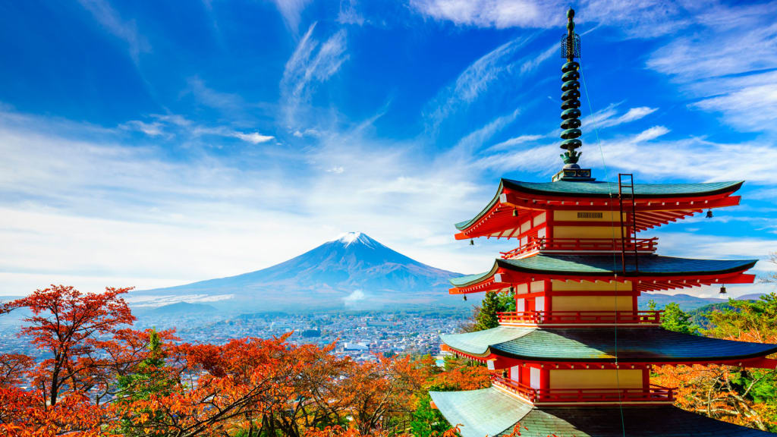

Slide 5
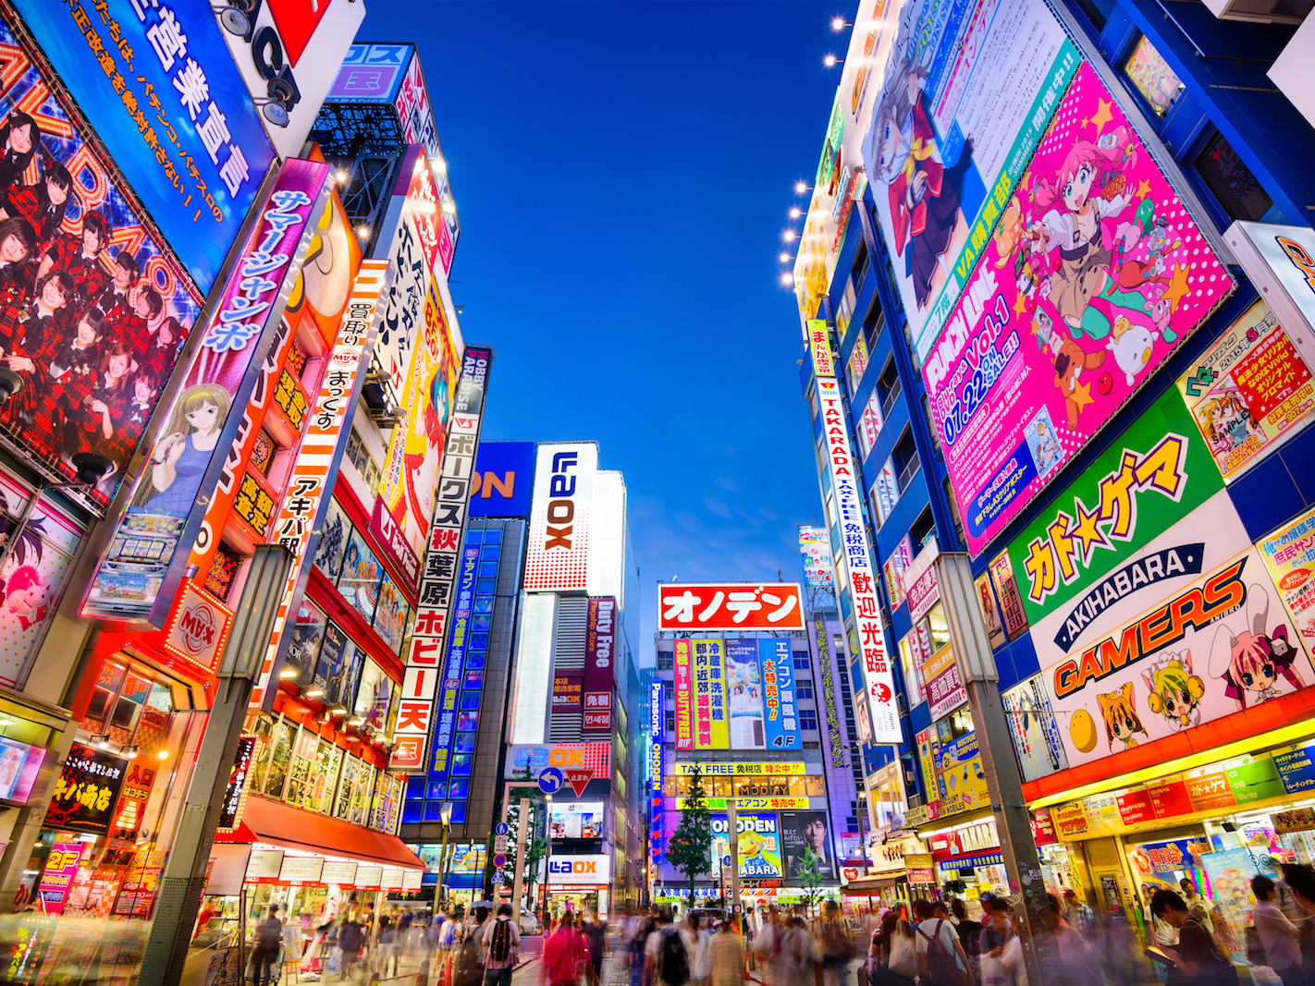

Slide 6
Business in japan
If you need a fork, be careful not to ask for it.
They do say 'no,' and they say it often.
It's better not to bow than to bow badly.
When to add '-san' to a coworker's last name, and when to go sans '-san.'
If you've said "Sayonara" to someone, you might as well have said "Farewell."

Slide 7
Business in Japan
That's why you won't need to ask for a fork, here's why you shouldn't ask. The Japanese derive meaning from what is left 'unsaid' and rely on context. So asking for a fork could unintentionally signal that you have no desire to learn about their culture — e.g., if you're unwilling to learn about chopsticks, how would you handle more critical business situations with bigger cultural differences?
-Stuart Friedman
http://www.businessinsider.com/6-things-to-know-about-business-in-japan-2014-6

Slide 8
Business in Russia

Slide 9
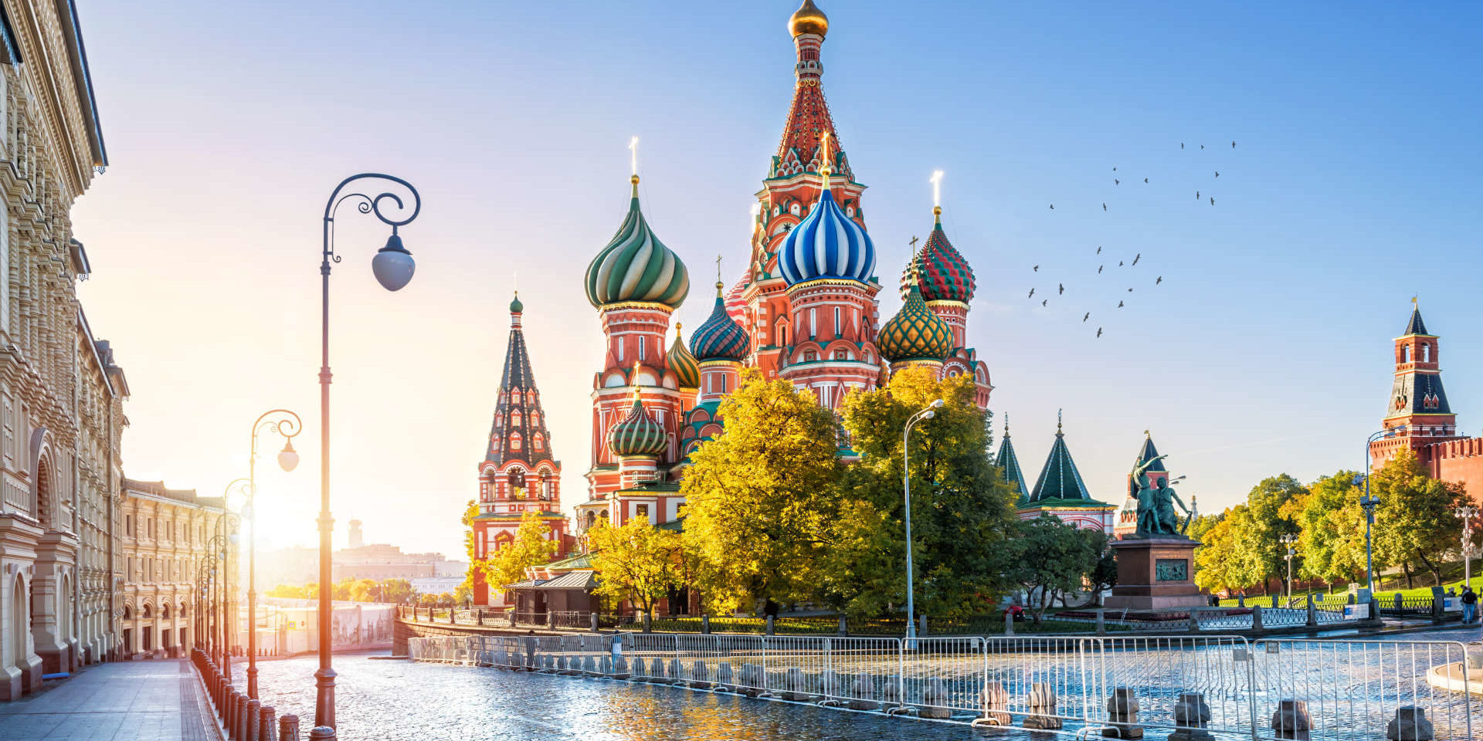

Slide 10
get formal language and titles right.
Russian business culture is not homogenous.
No messing arround at work!
People want to get to know whom they’re doing business with.
Remember holidays and birthdays.
Mobile phones for relationships.
Evaluate and train your employees.
Get something in writing if you can.
Doing business in Russia requires flexibility.

Slide 11
Business in London

Slide 12


Slide 13
Business in London
Punctuality
Gift giving
Business dress code
Educational standards

Slide 14
Cultural taboos such as:
greeting strangers with a kiss
gestures such as backslapping and
hugging strangers
spiting in public
asking personal or intimate questions such as
“How much money do you earn?” or
“Why did you divorce?”

Slide 15
That is it! Thanks for standing by! :,D

